Slide 1




Safeguarding
What you need to know
Working together to keep the people of Leicester, Leicestershire and Rutland safe

Slide 2
Safeguarding means protecting an adult’s and a child’s right to live in safety, free from abuse and neglect.

Slide 3
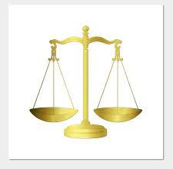
What does the Law say?

Slide 4

Adults
The Care Act 2014 sets out a clear legal framework for how local authorities and other parts of the system should protect adults at risk of abuse or neglect.

Slide 5
Care Act 2014 – Adult at Risk
Safeguarding adults became a statutory duty under the Care Act 2014.
Safeguarding duties apply to an adult (this is someone 18 and over) who meets all the below:
Has needs for care and support (whether or not the local authority is meeting any of those needs) and;
Is experiencing, or at risk of, abuse or neglect and;
As a result of those care and support needs is unable to protect themselves from either the risk of, or the experience of abuse or neglect.

Slide 6
Who Might This Include?
People with learning disabilities
People with physical disabilities
People with sensory disabilities
People with mental ill health
People who are frail due to their age
People with dementia
People who misuse drugs or alcohol
People with brain injuries

Slide 7
Adult Safeguarding Definition of Abuse
The term abuse is defined as:
A violation of an individual’s human and civil rights by any other person; or persons which may result in significant harm
Abuse may be:
A single act or repeated acts; an act of neglect or a failure to act; multiple acts (for example, an adult may be neglected and financially abused)
Taken from Leicester, Leicestershire & Rutland Safeguarding Adults Multi-Agency Policy & Procedures

Slide 8
Adult Safeguarding Definition of Abuse
Continued:
Abuse is about the misuse of the power and control that one person has over another.
Where there is dependency, there is a possibility of abuse or neglect unless adequate safeguards are put in place.
Intent is not necessarily an issue at the point of deciding whether an act or a failure to act is abuse; it is the impact of the act on the person and the harm or risk of harm to that individual.
Acts of abuse may constitute a criminal offence.
Taken from Leicester, Leicestershire & Rutland Safeguarding Adults Multi-Agency Policy & Procedures

Slide 9

Safeguarding Children
The Children Act 1989 is the key piece of legislation that talks about safeguarding children.
However, there have been other pieces of legislation since, such as Children Act 2004 and The Children and Social Work Act 2017.
So that practitioners know what to do, the Department for Education publishes guidance – the most recent is:
“Working Together to Safeguard Children 2026”.

Slide 10
Children’s Safeguarding Definition of Abuse and Neglect
Abuse and neglect are forms of maltreatment of a child.
“Somebody may abuse or neglect a child by inflicting harm, or by failing to act to prevent harm. Harm can include ill treatment that is not physical as well as the impact of witnessing ill treatment of others. This can be particularly relevant, for example, in relation to the impact on children of all forms of domestic abuse, including physical abuse, sexual abuse, emotional and psychological abuse, coercive and controlling behaviour and economic or financial abuse, where they see, hear, or experience its effects.
Children may be abused in a family or in an institutional or extra-familial context by those known to them or, more rarely, by others.
Abuse can take place wholly online, or technology may be used to facilitate offline abuse.
Children may be abused by an adult or adults, or another child or children. This includes in teenage relationships, and ‘honour’, faith- or belief-based abuse.”
Working Together to Safeguard Children 2026
A child is defined in Working Together to Safeguard Children 2026 as “anyone who has not yet reached their 18th birthday”.

Slide 11
Is abuse always intentional?
No!
It can be the result of negligence or ignorance.
Sometimes it can be the result of well-intentioned actions but remember that ABUSE is about the impact of the act on the individual, not the intent.

Slide 12
Children’s Abuse & Definitions
Abuse can be viewed in terms of the following categories
All definitions have been taken from Working Together to Safeguard Children 2026
Emotional
Physical
Sexual
Neglect

Slide 13
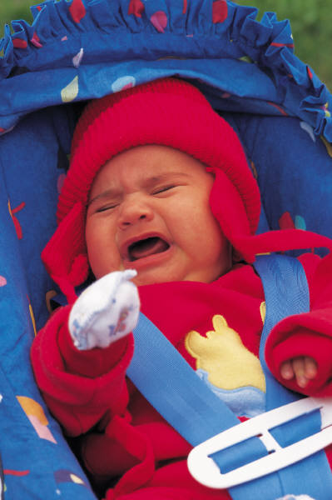
Physical Abuse Children
Physical Abuse – Children
A form of abuse which may involve hitting, shaking, throwing, poisoning, burning, or scalding, drowning, suffocating, or otherwise causing physical harm to a child. Physical harm may also be caused when a parent or carer fabricates the symptoms of, or deliberately induces, illness in a child.

Slide 14
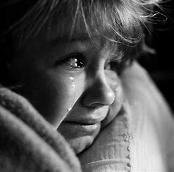
Emotional Abuse – Children
The persistent emotional or psychological maltreatment of a child so as to cause severe and persistent adverse effects on the child’s emotional development. […] Some level of emotional abuse is involved in all types of maltreatment of a child, though it may occur alone.

Slide 15
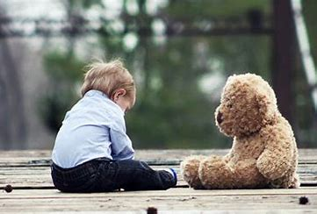
Neglect – Children
The persistent failure to meet a child’s basic physical and/or psychological needs, likely to result in the serious impairment of the child’s health or development. Neglect may occur during pregnancy as a result of maternal substance abuse. Once a child is born, neglect may involve a parent or carer failing to:
provide adequate food, clothing, and shelter (including exclusion from home or abandonment)
protect a child from physical and emotional harm or danger
ensure adequate supervision (including the use of inadequate caregivers)
ensure access to appropriate medical care or treatment
provide suitable education
It may also include neglect of, or unresponsiveness to, a child’s basic emotional needs.

Slide 16

Sexual Abuse – Children
Involves forcing or enticing a child or young person to take part in sexual activities, not necessarily involving a high level of violence, whether or not the child is aware of what is happening.
The activities may involve physical contact, including assault by penetration (for example, rape or oral sex) or non-penetrative acts, such as masturbation, kissing, rubbing, and touching outside of clothing.
They may also include non-contact activities, such as:
involving children in looking at, or in the production of, sexual images
watching sexual activities
encouraging children to behave in sexually inappropriate ways
grooming a child in preparation for abuse.
Sexual abuse can take place in family settings, in institutional settings, online, and technology can be used to facilitate offline abuse. Child sexual abuse material available online may have been generated in a family environment. Online abuse can also take the form of cyber-grooming or self-generated sexual content under coercion.
Sexual abuse is not solely perpetrated by adult males. Women can also commit acts of sexual abuse, as can other children. A child of any age or gender can be a victim of sexual abuse.

Slide 17
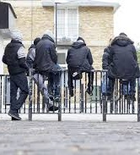
Extra-familial harm – Children
Children may be at risk of or experiencing physical, sexual, or emotional abuse and exploitation in contexts outside their families or the home they live in, such as a children’s home or foster home.
While there is no legal definition for the term extra-familial harm, it is widely used to describe different forms of harm that occur outside the home.
Children can be vulnerable to multiple forms of extra-familial harm from both adults and/or other children and harm may be perpetrated or facilitated by individuals or groups. Examples of extra-familial harm may include (but are not limited to):
criminal exploitation (such as county lines and financial exploitation)
serious violence
modern slavery and human trafficking
online harm
sexual exploitation (including group-based child sexual exploitation)
child-on-child (non-familial) sexual abuse and other forms of harmful sexual behaviour displayed by children towards their peers
abuse, and/or coercive control, children may experience in their own intimate relationships (sometimes called teenage relationship abuse)
the influences of extremism which could lead to radicalisation.
(Working Together to Safeguard Children 2026)

Slide 18
Some of the signs that might be an indicator that a child is experiencing abuse or neglect:
Unexplained changes in behaviour or personality
Becoming withdrawn/seeming anxious
Becoming uncharacteristically aggressive
Lack of social skills and few friends, if any
Poor bond or relationship with a parent
Knowledge of adult issues inappropriate for their age
Running away or going missing
Always choosing to wear clothes that cover their body
Unexplained injuries / inconsistent explanations
You may also notice some concerning behaviour from adults who have children in their care
Isolation
Restrictive movements or access to personal resources

Slide 19
Adult Abuse & Definitions
Abuse can be viewed in terms of the following categories:
Psychological
Self-Neglect
Financial or Material
Physical
Domestic Abuse
Discriminatory
Organisational
Modern Slavery
Sexual
Neglect and Acts of Omission

Slide 20
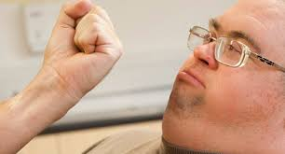
Physical Abuse
DEFINITION
Physical mistreatment of one person by another which may or may not result in physical injury.
TYPES Assault, hitting, slapping, pushing, misuse of medication, poor moving and handling, restraint or inappropriate physical sanctions.
SIGNS
Unexplained injuries
Unexplained bruises
Wounds on: face, lips, mouth, arms, torso, back, buttocks, thighs
Lacerations/abrasions: mouth, lips, gums, eyes, external genitalia
Marks on body: finger marks, hand prints

Slide 21
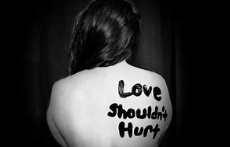
Domestic Abuse
DEFINITION
Incident or pattern of incidents of controlling, coercive or threatening behaviour, violence, stalking, or abuse, between those aged 16 or over who are or have been intimate partners or family member regardless of gender or sexuality.
TYPES Psychological, physical, sexual, financial, emotional abuse, so called ‘honour’ based violence, Female Genital Mutilation and forced marriage.
SIGNS
Withdrawn, bruising, suddenly behaves differently, can be anxious, clingy, depressed, aggressive, problems sleeping, eating disorders, wets, soils clothes, takes risks, misses attending services or appointments, changes in eating habits, obsessive behaviours, nightmares, drugs, alcohol, self-harm, thoughts about suicide, often accompanied at all times by perpetrator.

Slide 22
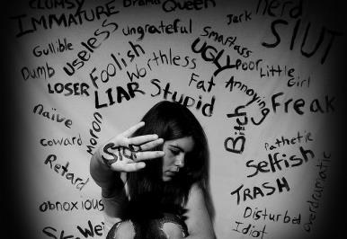
Psychological Abuse
DEFINITION
Action or neglect by the carer or any person that while not of a physical nature severely impairs the psychological or well-being of the person.
TYPES Emotional abuse, threats of harm or abandonment, deprivation of contact, humiliation, blaming, controlling, intimidation, coercion, harassment, verbal abuse, cyber bullying, isolation or unreasonable and unjustified withdrawal of services or supportive networks.
SIGNS
Change in appetite (weight loss or weight gain)
Deference
Passivity
Resignation
Emotional withdrawal / Low self-image
Unexplained fear
Sleep disturbance

Slide 23
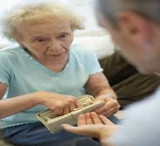
Financial/Material Abuse
DEFINITION
Misappropriation or misuse of money/assets. Transactions to which the person could not consent, or which were invalidated by intimidation/deception.
TYPES Theft, fraud, internet scamming, coercion in relation to an adult’s financial affairs or arrangements, including in connection with wills, property, inheritance or financial transactions, or the misuse or misappropriation of property, possessions or benefits.
SIGNS
Unexplained financial problems, unexplained bank account activity
Recent changes of deeds or title of property
Unusual interest by other in the person’s financial affairs or assets
Misuse of the person’s money by others
Uncooperative Power of Attorney, unpaid bills
Not accessing activities

Slide 24
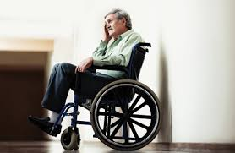
Neglect
DEFINITION
Behaviour by carers that results in the persistent or severe failure to meet the physical and/or psychological needs of an individual in their care.
TYPES Ignoring medical, emotional or physical care needs, failure to provide access to appropriate health and support or educational services, the withholding of the necessities of life, such as medication, adequate nutrition and heating.
SIGNS
Physical condition of the person, bed sores, ulcers, unkempt – dirty clothes, person unwashed, dirty hair or nails
Poor, inappropriate or unsafe environment, hoarding, inadequate diet and malnutrition
Failure to give/take medication, untreated medical problems
Isolated, won’t socialise/ not encouraged to socialise

Slide 25
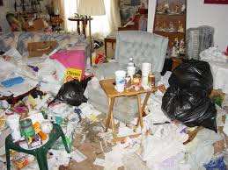
Self-Neglect
DEFINITION OF SELF-NEGLECT
This includes a wide range of behaviour neglecting to care for one’s personal hygiene, health or surroundings.
TYPES Hoarding Not looking after personal hygiene Failure to tend to own health needs and seek medical care/advice and treatment as and when required
SIGNS
Physical condition of the person, bed sores, ulcers, unkempt, dirty clothes, person unwashed, dirty hair or nails
Poor, inappropriate or unsafe environment, hoarding, inadequate diet and malnutrition
Failure to take medication, untreated medical problems
Isolated, won’t socialise

Slide 26
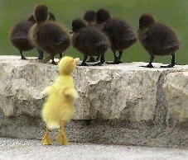
Discriminatory Abuse
DEFINITION
Any form of abuse based on discrimination because of a person’s race, culture, belief, age, gender, disability, sexual orientation, etc. Discrimination may be a motivating factor in other forms of abuse.
TYPES Forms of harassment, slurs or similar treatment. Personal discrimination: name calling, isolating, harassing, hate crime. Organisational discrimination: withholding services, failing to meet cultural or religion needs.
SIGNS
Lack of respect shown to an individual
Sub-standard service to an individual
Exclusion from rights, services or activities that others have
Prejudicial attitudes towards others based on their gender, sexual orientation, race, belief, etc.
Failure to accommodate dietary needs
Not helping people to practice their faith

Slide 27
Sexual Abuse
DEFINITION
The involvement of a person in sexual activities or relationships that either they do not want and have not consented to, or they cannot understand.
TYPES Rape, indecent exposure, sexual harassment, inappropriate looking or touching, sexual teasing or innuendo, sexual photography, subjection to pornography or witnessing sexual acts, indecent exposure and sexual assault and sexual assault or sexual acts to which the adult has not consented or was pressured into consenting.
SIGNS
Changes in behaviour, mood swings, withdrawn/depressed, poor concentration
Pregnancy
No bowel control
Difficulties in walking or sitting
Blood-stained or soiled clothing
Bruises or injuries on: upper arms or thighs
Pain, bleeding
Itching in the genital area

Slide 28
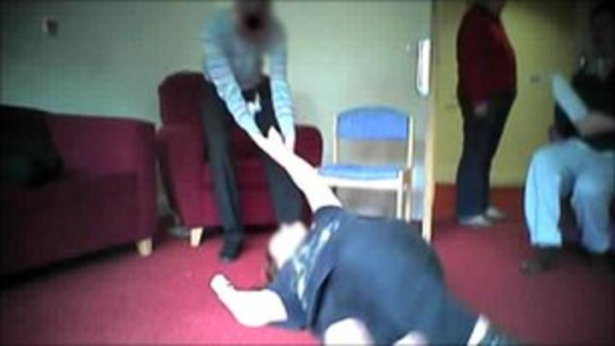
Organisational Abuse
DEFINITION
Repeated incidents of poor professional practice or neglect. Inflexible services based on the needs of providers rather than the person receiving services.
TYPES Neglect and poor care practice within an institution or specific care setting such as a hospital or care home, for example, or in relation to care provided in one’s own home. This may range from one off incidents to ongoing ill treatment. It can be through neglect, poor professional practice as a result of the structure, policies, processes and practices within an organisation.
SIGNS
Inappropriate or poor care/lack of flexibility in the care regime
Sensory deprivation/denial of aids – hearing aids, glasses, walking frame, etc.
Lack of choice – meal times, food, clothes, etc.
Lack of personal possessions/lack of privacy or dignity
Attitudes and behaviour of staff towards service users

Slide 29
Modern Slavery
DEFINITION
Traffickers and slave masters use whatever means they have at their disposal to coerce, deceive and force individuals into a life of abuse, servitude and inhumane treatment.
TYPES Human trafficking/forced labour, domestic servitude/sexual exploitation
SIGNS
Is not free to leave or come and go, poor mental health, fearful, anxious, depressed, submissive, tense, nervous/paranoid, fearful or anxious, avoids eye contact. Poor physical health, appears malnourished, shows signs of physical and/or sexual abuse, physical restraint, confinement, or torture, lack of control, has few or no personal possessions, not in control of own money, no financial records, or bank account, is not allowed or able to speak for themselves (a third party may insist on being present and/or translating).
Has numerous inconsistencies in their story.

Slide 30
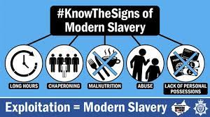
Nail Bars
Car Washes
Care Homes
Construction
Agriculture
Hotel & Restaurant
Modern slavery doesn’t happen in all nail bars, car washes etc; however, these are the workplaces where incidents have been reported.

Slide 31

Wider Community Safety
When it comes to safeguarding, we all need to be vigilant, in both our everyday lives as well as our working life.
Raising awareness is the first step.

Slide 32

Concerns about adults working with children
If you have concerns about a member of staff, a volunteer or a member of the public who is in a position of trust working with a child or young person, please contact the LADO (Local Authority Designated Officer)/Allegations Managers to discuss your concerns:
Leicestershire
  CFS-LADO@leics.gov.uk
  0116 305 4141
Leicester City
  Lado-allegations-referrals@leicester.gov.uk
  0116 454 2440
Rutland
  LADO@rutland.gov.uk
  01572 758 454

Slide 33

Concerns about adults working with adults
If you have concerns about a Person in a Position of Trust working with adults at risk, the concerns need to be raised with the relevant agency / organisation.

Slide 34
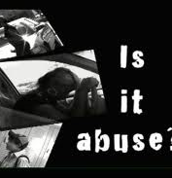
Even if abuse is not occurring, it may be a situation that someone needs support with.
Don’t worry that you have misunderstood a situation.
Within your role, it is not your job to investigate – just report.
Report any concerns you may have, as soon as possible.

Slide 35


The priority should always be to ensure the safety and protection of the adult or child at risk.
To this end, it is the responsibility of us all to act on any suspicion or evidence of abuse or neglect and to pass the concerns to a responsible person or agency.

Slide 36

Immediate safety and risk assessment
The safety and welfare of the individual is your main priority.
You should ensure the immediate safety and welfare of the adult or child at risk without putting yourself in any danger.
This may include:
Urgent medical attention or contacting the police on 999
In this event, take the necessary action immediately by reporting.

Slide 37

What if someone does not want me to report?
Explain to the person that you must report the concern if it’s safe to do so and won’t put them at risk.
It is vital to pass concerns on because:
Other people may be at risk.
There might be other issues that you’re unaware of.
You should not have to carry the responsibility alone.

Slide 38
Reporting concerns about adults
If you think an adult is being abused or neglected, you can report the abuse or neglect to the adult social care service where they live:
Leicester City: Telephone: 0116 454 1004 (operational 24 hours a day, 7 days a week)
Leicestershire: Telephone: 0116 305 0004 (Monday to Thursday, 8.30am to 5pm, Friday 8.30am to 4.30pm)
Emergency Duty Team for Leicestershire: Telephone: 0116 305 0888 (Evenings, weekends, Bank Holidays)
Rutland: 01572 758 341 (anytime, day or night)

Slide 39
Reporting concerns about children
If you think a child is being abused or neglected, you can report the abuse or neglect of the child to the children’s social care service where they live:
Leicester City: Telephone: 0116 454 1004
(open 24 hours a day, 7 days a week)
Leicestershire: Telephone: 0116 305 0005
(24-hour phone line)
Rutland: Telephone: 01572 758 407
(Open: Monday to Thursday, 8.30am to 5pm and Friday, 8.30am to 4.30pm. Outside of these hours, call: 0116 305 0005)

Slide 40
For more information, please refer to the Safeguarding procedures
Leicester, Leicestershire & Rutland Safeguarding Children Partnerships Procedures manual
https://llrscb.trixonline.co.uk/
Leicester, Leicestershire & Rutland Safeguarding Adults Boards Multi-Agency Policies & Procedures
https://www.llradultsafeguarding.co.uk/

Slide 41

Record your safeguarding concerns
Record your concerns accurately, including any minor concerns, and the details of any action you have taken, information you have shared and decisions you have made relating to those concerns.
Make records at the time the events happen, or as soon as possible afterwards.
If you work for an organisation, please follow your in-house recording procedures.

Slide 42

Safeguarding
is Everybody’s Responsibility

